Slide 1
How to complete the Stage 1 Evidence Gathering Registration Form
Gathering Evidence Safely: Cumberland Councils’ Research Governance Framework

Slide 2
What is this form for?
All evidence gathering for research must be registered so that everyone in the Council knows what research is being carried out
Completing this form will:
Register your research with the HDRC team
Enable you to consider and mitigate any risks that might be inherent in the activity
Ensures the HDRC team can offer you support in the design and conduct of your project.

Slide 3
Guidance on completing the form
Download the form and save it to sharepoint with the form name and project title
Project title – a title that tells you what the project is about is really useful. Try to avoid long titles where possible.
Name of lead council staff – this is the name of the person registering the project to whom all future communication will go. The other details collected help us to understand which part of the Council is doing this research.

Slide 4
Type of evidence gathering – this asks you how you think you might collect the evidence you need. We suggest a few methods of collecting evidence for you to select and you might want to add another method.
Type of evidence – this asks you whether you will be using existing data or whether you intend to generate new data. Select whichever is the most appropriate.
These questions help us to understand the overall nature of the project.

Slide 5
Who is leading the project – this box seeks to understand which organisation is leading the project. Select the best description and add more detail if none of the suggestions are correct.
What do you want to find out – please add a short description of what you want to find. You might have a question you’re trying to answer, a problem you’re trying to explore, or an idea to test out. Tell us why you are gathering evidence.
How do you plan to find it out – please add a short description of how you think the project will work. What will you do first, second, third. Who or what will be involved? Let us know if these are initial ideas or a firm project plan.

Slide 6
Link to Cumberland Council’s Strategic Plan – we are all working towards the delivery of the strategic plan. Please indicate here how strongly you feel this project aligns to the strategic plan. Feel free to add some comments.
Link to research plans – there are a range of research plans in the Council at a strategic level, directorate level and in community panels. Please let us know which research plan, if any, this project supports.
Start and end date – this helps us to understand when the project activities will be live.

Slide 7
How sensitive is the topic or subject of the research?
Please highlight the box that you think best describes your research topic or subject.
4 - Highly sensitive | Evidence about ‘race’ or ethnicity; political opinion; religious, spiritual or other beliefs; physical or mental health conditions; sexuality and/or gender identity; abuse (child, adult); nudity and the body; criminal activities; political asylum; conflict situations; personal violence; and terrorism or violent extremism.
3 – Medium sensitivity | Confidential- Evidence includes confidential information such as beliefs, motivations and behaviours.
2 – Low sensitivity | Private- Evidence includes private information such as perceptions of services.
1 – Not sensitive | Public- Evidence gathering seeks to collate factual information that is held open access e.g. census data or national statistics.

Slide 8
How vulnerable are the participants?
4 - Highly sensitive | 3 – High vulnerability | People are involved in the evidence gathering whom you anticipate have vulnerabilities, for example; children aged under 16; those lacking mental capacity; or individuals in a dependent or unequal relationship, or who have prior experience of psychological or physical harm or adversity in its broadest sense.
3 – Medium sensitivity | 2 – Low vulnerability | People are involved in the evidence gathering who have no evident or obvious vulnerabilities.
2 – Low sensitivity | 1 – No people are involved | Evidence gathering involves no people and does not draw on anything said or created by people e.g. a literature review or evidence review.
1 – Not sensitive | Public- Evidence gathering seeks to collate factual information that is held open access e.g. census data or national statistics.
Please highlight the box that you think best describes your research participants.

Slide 9
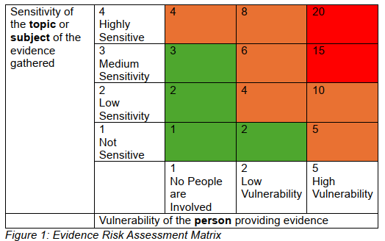
Overall risk assessment
Scores of 1-3 can start evidence gathering
Scores of 4 to 10 will need to prepare a stage 2 application
Scores of 10 or higher may need external ethical approval
The HDRC team will advise you of your next steps.

Slide 10
Next steps
Save and submit this form to the HDRC: HDRC@cumberland.gov.uk
The team will review your form and get back to you within two weeks to advise whether you can progress with your research (stage 4) or whether you need to do more planning (stage 2 or 3).
The HDRC team will also share with you any contacts in the Council conducting similar pieces of work, connections with experts in our academic institutions who may be able to help, and knowledge of any similar bodies of research evidence.

